Slide 1
Chester, Cavaliers and Cannons
Dr Sam Chadwick s.chadwick@chester.ac.uk
Notes:
Hello, this is me

Slide 2








VS
Notes:
I’m here to talk about a time when a great issue brought a split in society, causing trouble and strife for the whole Kingdom over many years. Not only were there two loose factions, but within each were sub-factions and dissenting opinions which warred with each other.
Luckily I won’t even mention the B word, and will go to a much nicer time, filled with ire and violence.

Slide 3
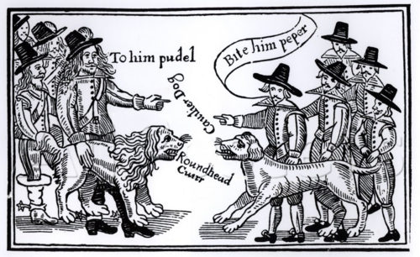
The Civil War: 1642-1646, 1648-1649 and 1649-1651
Notes:
The Civil War, or perhaps more accurately wars, was a period of turmoil during the mid seventeenth century with three outbreaks of war, 1642-1646, 1648-1649 and 1649-1651.
The war erupted due to a myriad of complex ideas, but primarily it was over three aspects, religion, money and who held the power over the future of the country. Controversy never really changes.
By the end of the wars, around 10,000 houses had been destroyed the King had been beheaded, the Kingdom became a republic, and as a result of the bloodshed, and ensuing famines and plagues, a large portion of the population died.
Although modern histories have often tended to focus upon major national campaigns and principal armies occasionally clashing in glorious and decisive battles, sieges were also a key part of the English Civil Wars. Indeed, much of the course of the war was decided by small skirmishes, assaults and long drawn out actions which came with these.

Slide 4
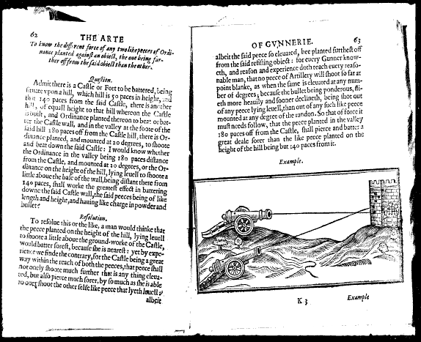
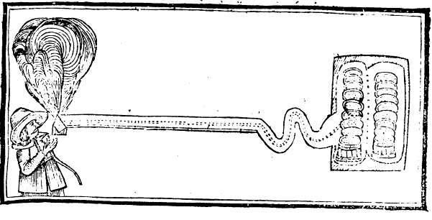
Siege Warfare
Notes:
My personal study area of study is looking at sieges, artillery and a concept called the Military Revolution, the idea that technology and organisation suddenly jumps forward. Out of these, we are only really looking at the first war, 1642-46 as that is when Chester is really caught up.
There were many different tactics that were used during this period in attempts to threaten and cajole the populace into surrendering or to break into a locations defences, here we have two of the main tactics to breach a wall, that of battery with cannon and by detonating a mine beneath the fortification.

Slide 5
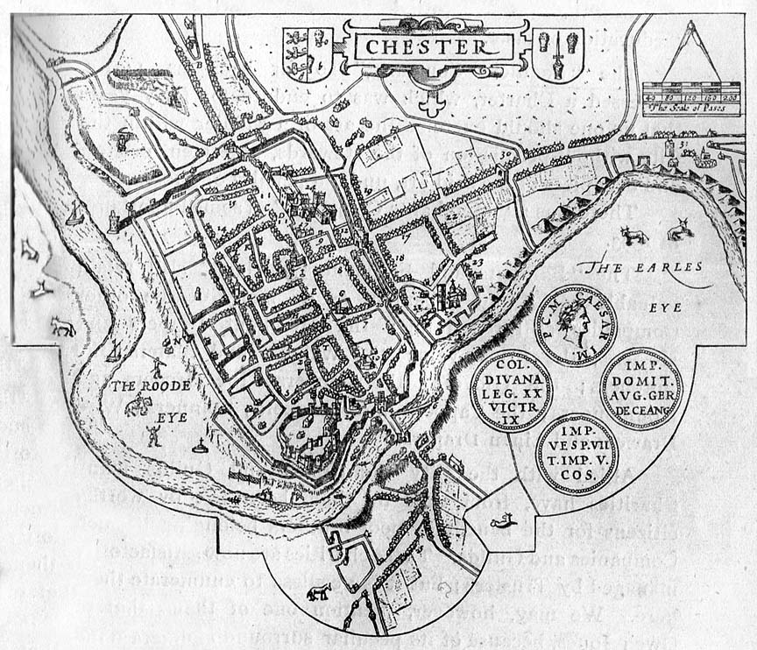
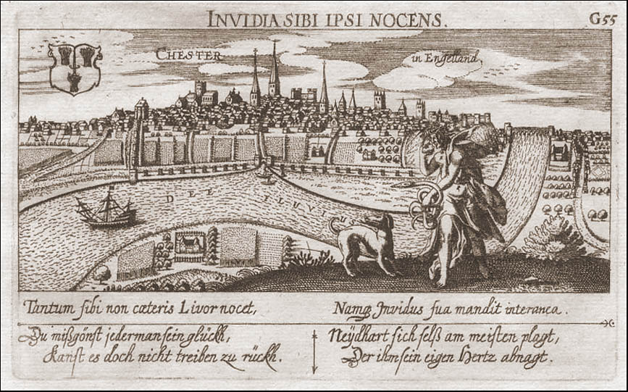
17th Century Chester
John Speed’s 1612 map
Daniel Meisner’s portrait of Chester
Notes:
Here we have Chester from above and from across the River Dee looking at the Watergate – on the golf course looking out.
Prior to the commencement of hostilities, Chester was one of the major cities in England. It was a large trading port, had considerable rights and privileges and was considered the key to Ireland, with strong royal and non-royal seaborne links to and from Dublin. It had many links to the Crown, including a royal charter of 1506, but initially as war broke out in summer 1642 its allegiance was uncertain with plenty of evidence of neutralism, including a declaration that it would not get involved in the civil war.
When the Parliamentarian general, William Brereton attempted to bring the city out for parliament, he was kicked out.
Only after the king visited Chester in autumn 1642 was it secured by the royalists and its allegiance was cemented in the early months of 1643 with the installation of a royalist garrison
At the same time, the aforementioned Brereton took much of central and eastern Cheshire creating a wave of royalists who retreated to this stronghold.

Slide 6
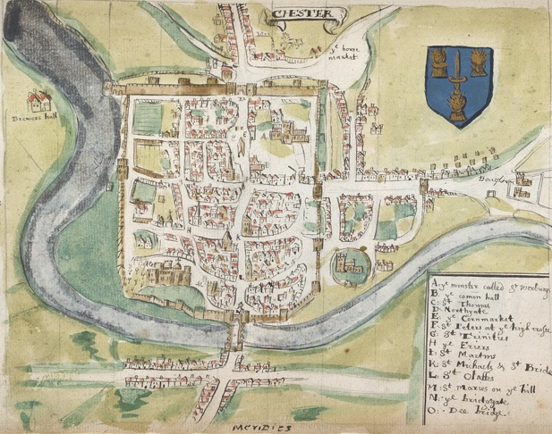
From Smith, W., drawing from the British Library, presumably as a draft for Smith W., The Particuler Description of England, (Hertford: S. Austin and Sons, 1588).
Notes:
The walls around Chester were originally built during its time as a Roman legionary fort and their layout followed the classic Roman design of a rectangle with rounded corners (playing card shaped).
These walls were extended during the mediaeval period, such that the town was enclosed by a much larger and more irregularly shaped circuit following the Roman line on the east and north side but pushing southwards and westwards, closer to the line of the looping River Dee.
Following the Conquest, Chester Castle was constructed in the south west corner of the walled town though the castle walls were always separate from the town walls.
Although the town walls were reinforced during the first civil war, the siege demonstrates that these centuries old structures were still a significant defence.

Slide 7
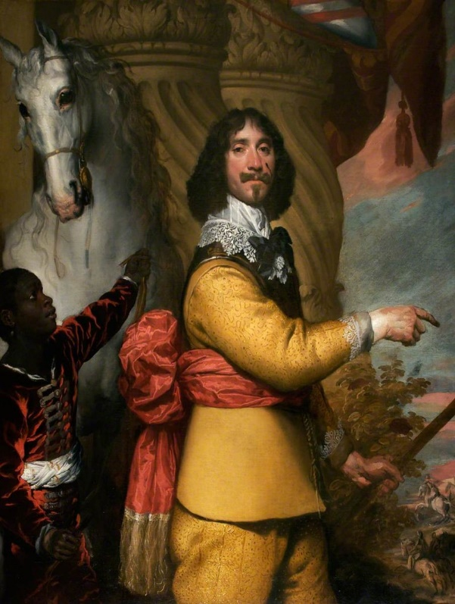
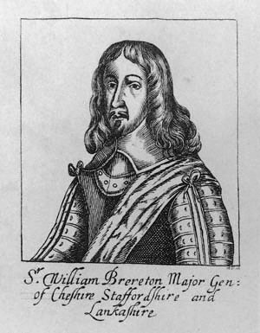
The Siege
Notes:
The siege of Chester was fought, primarily, between two key commanders, the royalist Lord John Byron and the parliamentarian commander Sir William Brereton. Both of these were more statesmen than skilled soldiers.
Chester was an important strategic location it was on the main route to northern Wales and from there onto Ireland, it served as a major west coast port and possible landing place for royalist reinforcements from Ireland and it was also probably the largest town in north west England and the north Wales region
Brereton was certain that Chester was an important location, ‘whose contrition and reducing thereof will find much by the settling of all these parts of the kingdom of England and Wales and may have a great influence and also upon Ireland’.

Slide 8
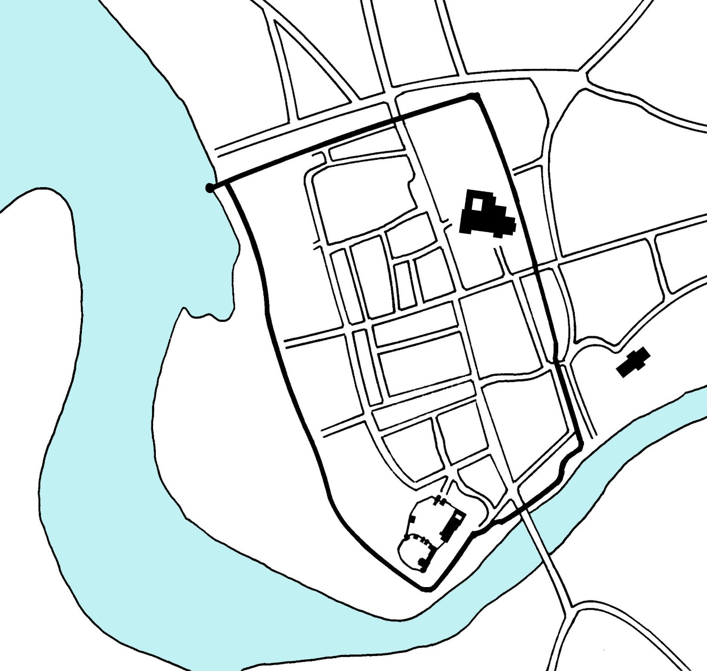
Four Phases of the Siege
January 1643 – March 1644
March 1644 – November 1644
November 1644 – September 1645
September 1645 – February 1646
Notes:
The history of the city’s involvement in the war can be seen in four phases.
The first phase lasted from January 1643 to March 1644, during which time Chester was mostly out of direct conflict, though Sir William Brereton had taken much of the county for Parliament. During this time, extensive defensive outworks were built around Chester and its suburbs.
The second phase stretched from March to November 1644 when the defences were shortened and improved by Prince Rupert.
The third phase was when the siege properly happened, prior to that is had been loose bombardment. By November 1644, the royalists were lacking forces and the Parliamentarians could tighten on the city.
The final phase lasted from October 1645 to February 1646. By this stage all hopes of relief had This phase consisted of the main bombardment of Chester and ended with its surrender on 3 February 1646.

Slide 9
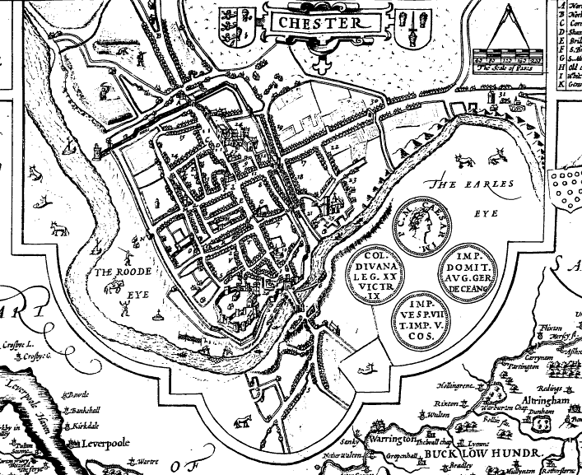
Phases 1 and 2
Chester takes a side
Notes:
From late 1642 onwards they began throwing up earthwork mounts, and in earl 1643 they requested artillery from a nearby ship to help defend the city.
Initially these works were extremely grand in nature jutting out all the way into Hoole when many of the rich houses were. These were purely political grabs, holding upstanding people’s houses, not for tactical nesscessity.
Meanwhile Brereton’s forces snuck up the west side of the Dee. However these pulled back upon hearing that royalist reinforcements were arriving.
Prince Rupert, who unlike the rest of the people he was a veteran of the wars that had been raging over on the continent, came in and cut back the defences dramatically, pulled down and burned large areas of the suburbs. Indeed you can still see some of the modifications he made, Prince Rupert’s trench by the university is part of these improved defences.
While there was some shots fired during this period, this siege was incredibly loose.

Slide 10
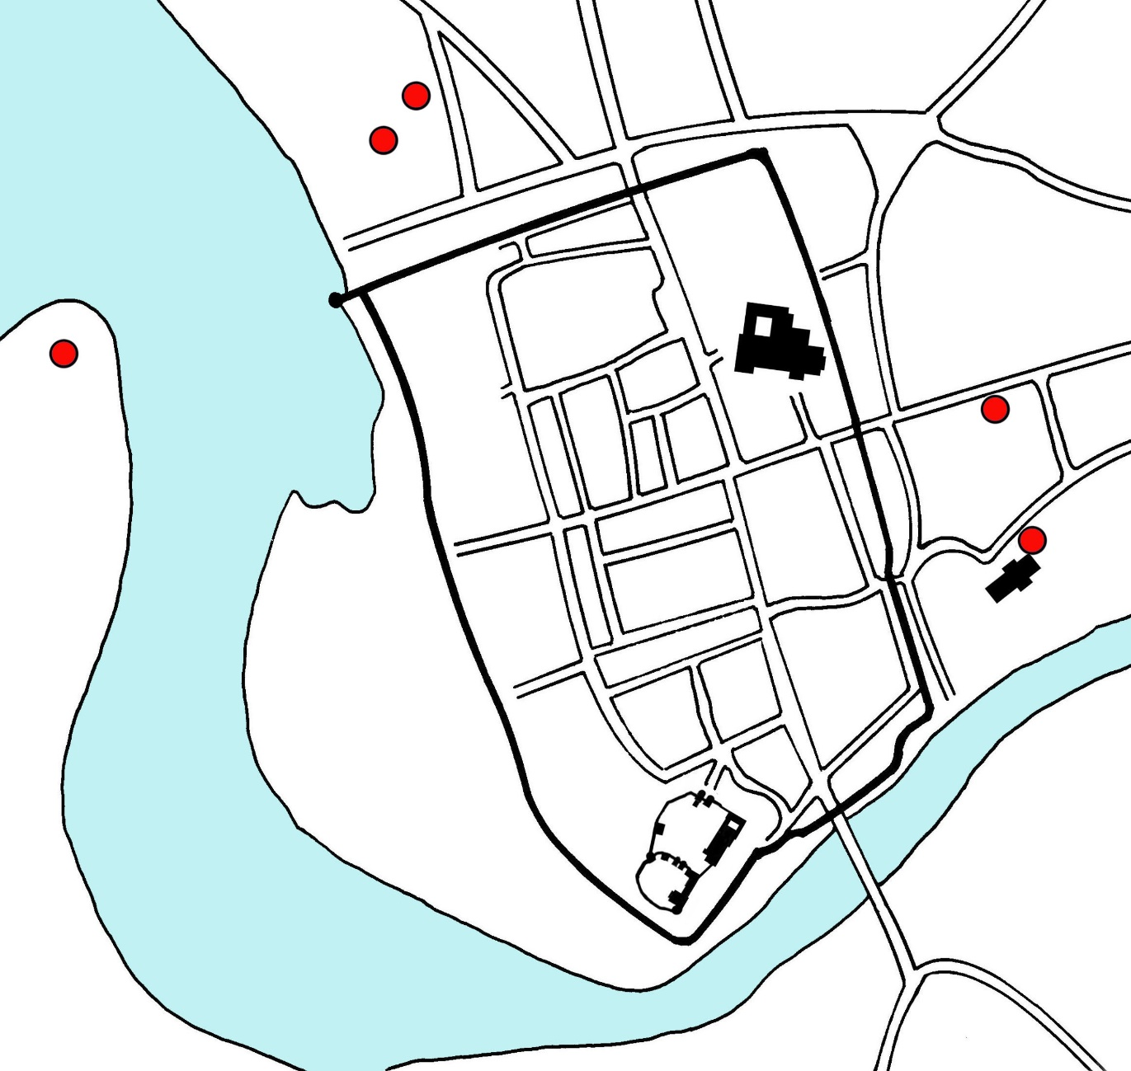
Phases 3 and 4
Chester under fire
Notes:
The third phase came about following the royalists’ defeat at Montgomery. Here a large number of royalist troops were destroyed, which meant that Lord John Byron, Chester’s governor, was no longer able to meet the parliamentarian forces in the field. This gave the parliamentarians the freedom to start the first part of the siege of Chester.
Following a failed parliamentarian attack on the northern outworks in January 1645, the siege was partially relieved by Prince Maurice on 19 February 1645, but this relief did not last long as, a second successful attack using the cover of darkness the eastern suburbs of Chester were taken by parliamentarians on the 20 September 1645. This is when the fourth, most intense phase began.
Then came the tight siege as displayed above, here we can see the batteries. The largest gun was place on the west side of Chester here, and bombarded the city. While this did lots of damage to the general infrastructure, this was considered a poor choice tactically.
The two batteries at the top are confirmed batteries, Chester had a large gun at Morgan’s mount, which kept away parliamentarian siege works, but this was dislodged, and after that the parliamentarian batteries appears to have creeped forward.
The battery on Eastgate street included a large mortar, which one report states ‘threaten to set the city, if not the whole world alight’
The battery at Saint Johns included a small gun in the tower that allowed for shots to be fired from overhead, suppressing counter fire.
A breach (whose repairs can still be seen today in the Roman Gardens) was made by the Saint John’s Battery. Brereton, made a tactical blunder of giving the royalists time to fill the gap with mattresses and various defences, before an assault was sounded and the parliamentarians charged the breach. Not only did the garrison fight, but also many of the civilians, including a Frenchman who fought in his nightshirt.
While this was fought off, the siege continued, and following the loss of Royalist cause elsewhere in the country, Chester surrendered.
The siege ended with its surrender on 3 February 1646.

Slide 11
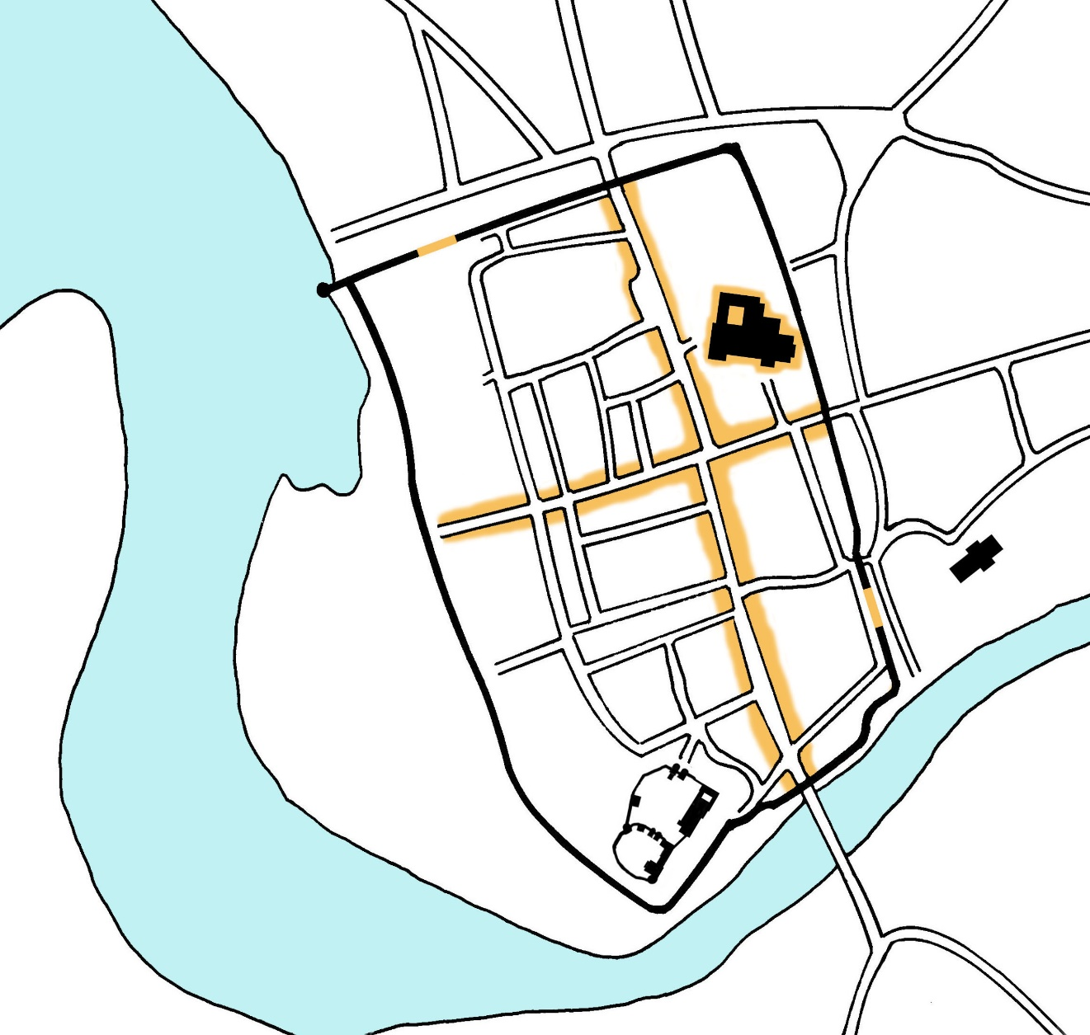
The Aftermath
Notes:
Here we have the highlighted areas of the damage known to have been received at Chester.
The main damage done to the city was caused by two pieces of ordnance in particular, the mortar located at Foregate Street and the large gun on Brewers Hall Hill located on the Welsh (west) side of Chester.
Chester’s siege was intense but not particularly active. Many other sieges had multiple violent sallies out, where Chester, because of both Brereton poor skill, and its good geographical position, meant that such gambles were not needed.
By the end of the war much of the city was damaged, and as a result of the casualties inflicted, along with being hit by a plague the following year, Chester had decayed to such an extent that grass grew in the main streets.

