Slide 1




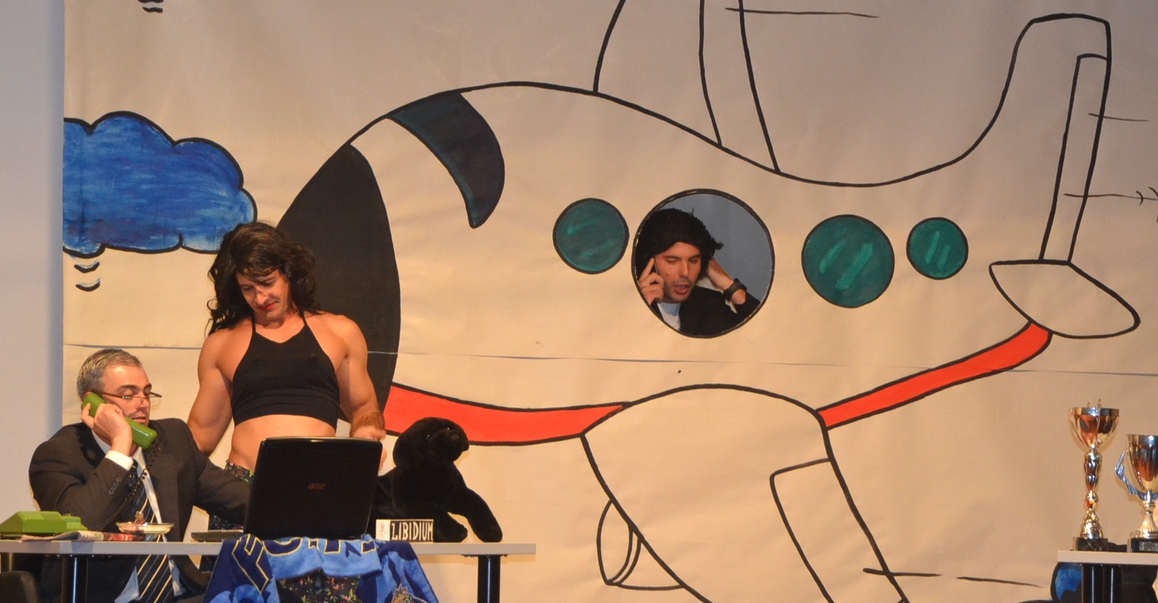
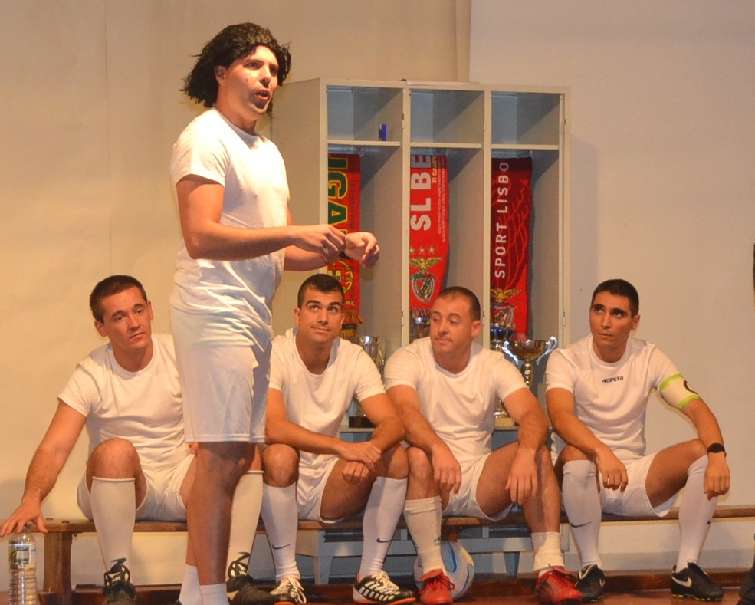

Arts in the Military
-A Theatrical Performance Exercise-
Susana Vasconcelos Tavares, Anne Pässilä, Allan Owens, Filipa Pereira.
IFKAD, June 2016

Slide 2
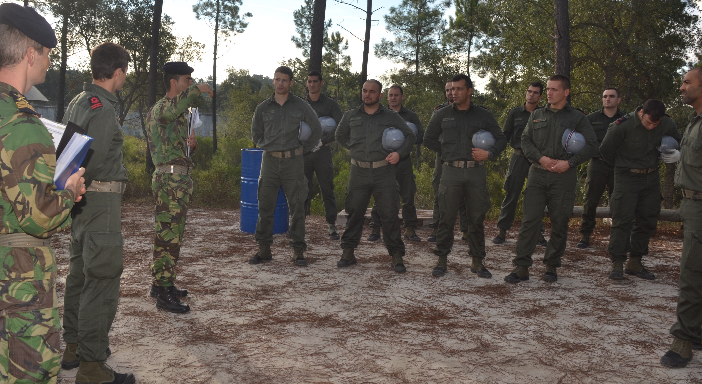
Arts in the Military – A Theatrical Performance Exercise
Theatrical Performance Exercise (TPE)
TPE involves:
Planning
Organizing
Creating
Performing
Karl E. Weick
Susana Vasconcelos Tavares, Anne Pässilä, Allan Owens, Filipa Pereira
IFKAD, June 2016

Slide 3
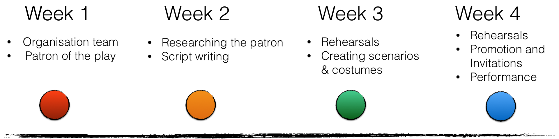
Arts in the Military – A Theatrical Performance Exercise
Theatrical Performance Exercise (TPE)
Timetable
Karl E. Weick
Susana Vasconcelos Tavares, Anne Pässilä, Allan Owens, Filipa Pereira
IFKAD, June 2016

Slide 4
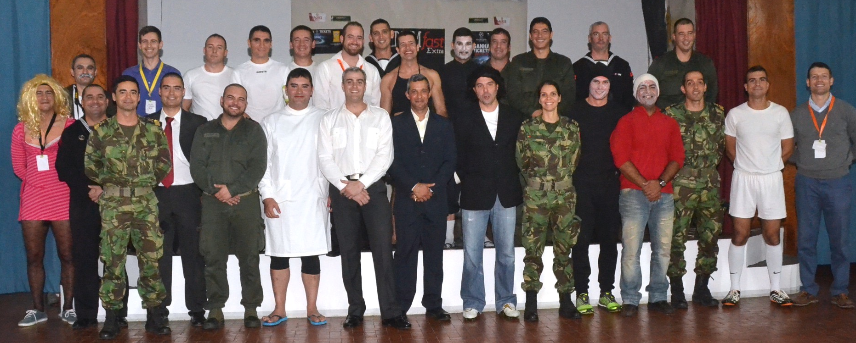
Arts in the Military – A Theatrical Performance Exercise
Data collection and Sample
Sample
Karl E. Weick
Susana Vasconcelos Tavares, Anne Pässilä, Allan Owens, Filipa Pereira
IFKAD, June 2016

Slide 5
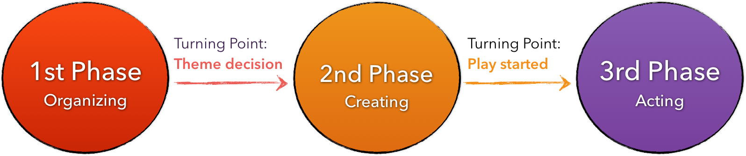
Arts in the Military – A Theatrical Performance Exercise
Methods and Interpretations
3 Phases of the TPE
Karl E. Weick
Susana Vasconcelos Tavares, Anne Pässilä, Allan Owens, Filipa Pereira
IFKAD, June 2016

Slide 6

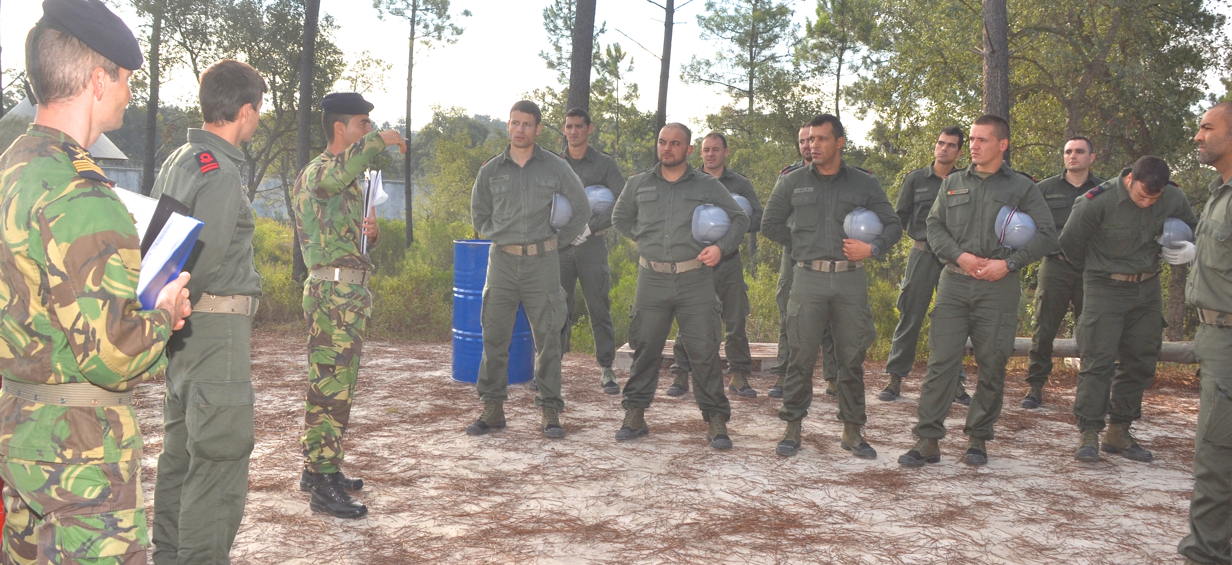
Arts in the Military – A Theatrical Performance Exercise
Methods and Interpretations
“A task out of my comfort zone, the first impact was almost shock.”
IFKAD, June 2016

Slide 7

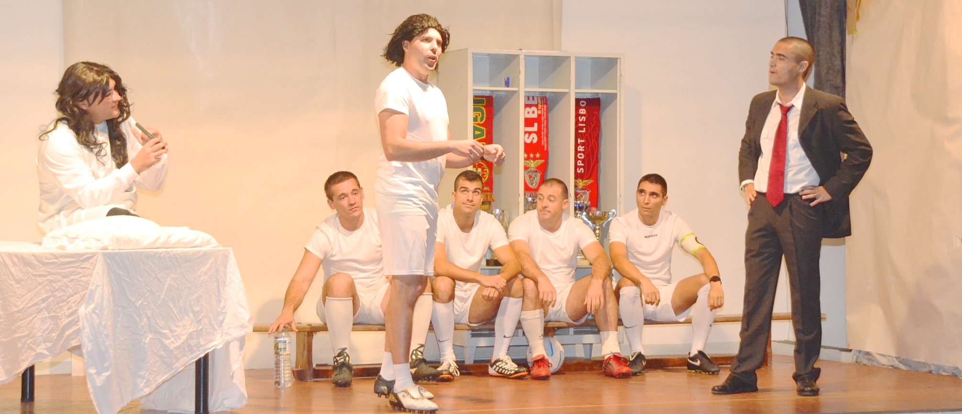
Arts in the Military – A Theatrical Performance Exercise
Methods and Interpretations
”Soon after came the rehearsals and from a sense of helplessness,
came the certainty that with work, we were going to make it”
IFKAD, June 2016

Slide 8
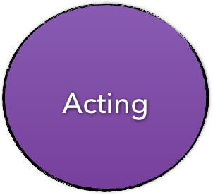
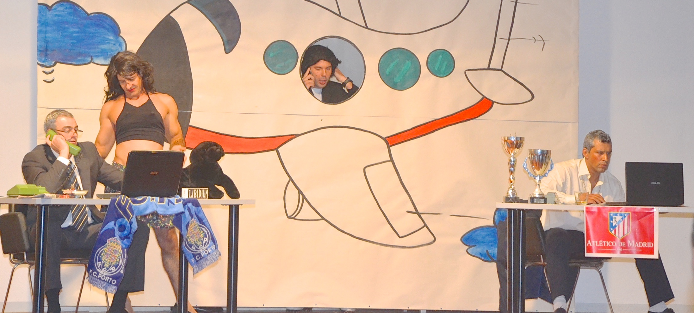
Arts in the Military – A Theatrical Performance Exercise
Methods and Interpretations
“I felt joy and good humor emotions during the play, and in the end, a sense of accomplishment.”
IFKAD, June 2016

Slide 9
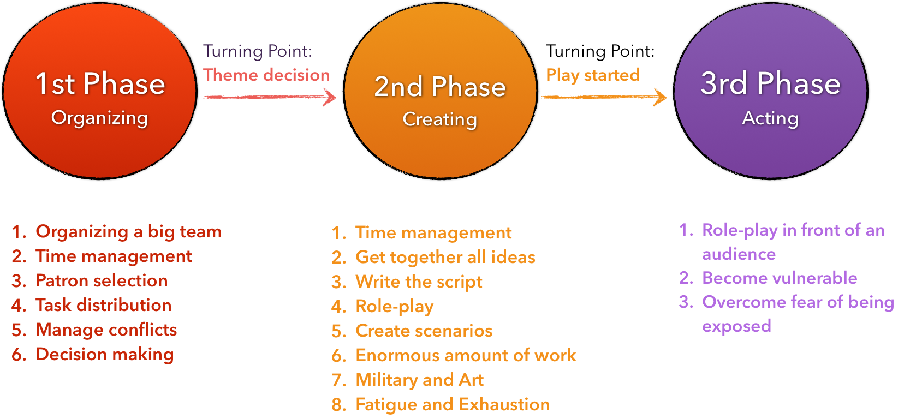
Arts in the Military – A Theatrical Performance Exercise
Methods and Interpretations
Summary of Challenges in each Phase
IFKAD, June 2016

Slide 10
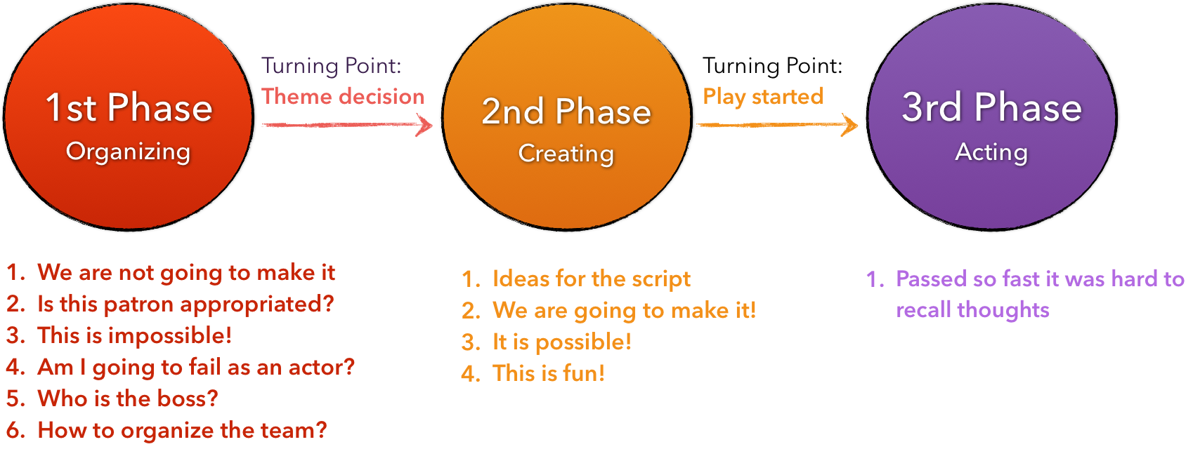
Arts in the Military – A Theatrical Performance Exercise
Methods and Interpretations
Summary of Thoughts in each Phase
IFKAD, June 2016

Slide 11
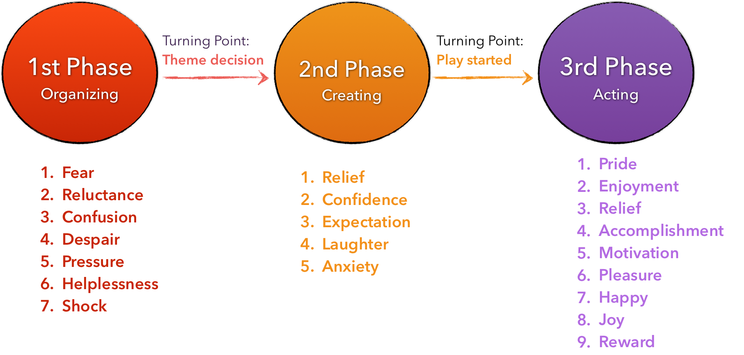
Arts in the Military – A Theatrical Performance Exercise
Interpretations and Results
Summary of Emotions and Feelings in each Phase
IFKAD, June 2016

Slide 12
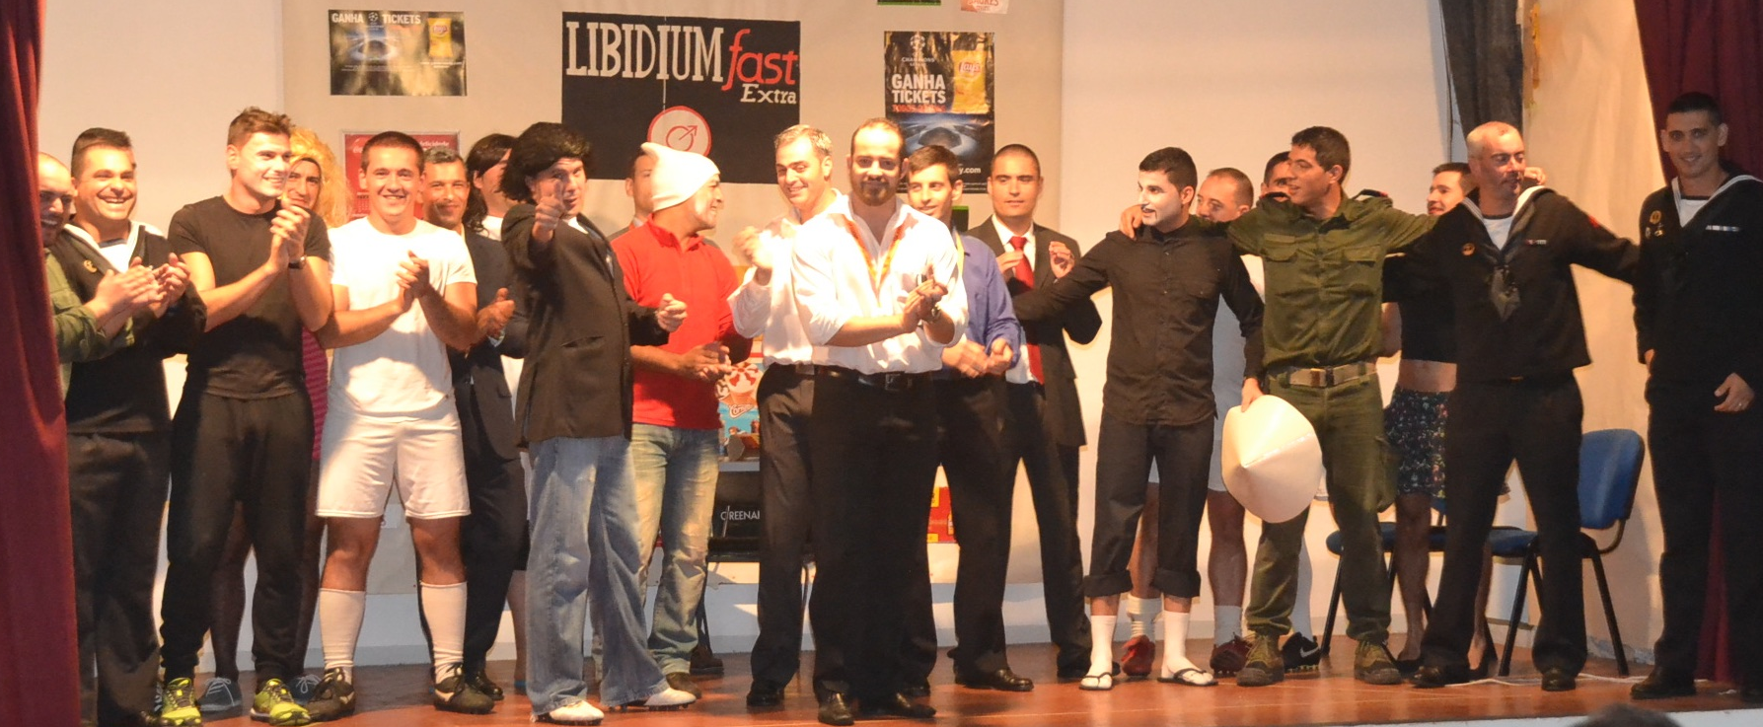
Arts in the Military – A Theatrical Performance Exercise
Methods and Interpretations
IFKAD, June 2016

Slide 13
Arts in the Military – A Theatrical Performance Exercise
Methods and Interpretations
5 Key value drivers
Learning Outcomes
Developing teamwork skills
Knowing better each team member
Increasing
Self-confidence &
self-respect
Improving Group Cohesion
IFKAD, June 2016

Slide 14
Arts in the Military – A Theatrical Performance Exercise
Limitations of the study
Methodology
Ethically: ????
Susana Vasconcelos Tavares, Anne Pässilä, Allan Owens, Filipa Pereira
IFKAD, June 2016

Slide 15
Arts in the Military – A Theatrical Performance Exercise
Thank you!
IFKAD, June 2016

Slide 16
Arts in the Military – A Theatrical Performance Exercise
References
Adams, J. and Owens, A.(2015). Creativity and Democracy in Education: the practice and politics of education through the Arts. Oxford, Routledge & Taylor Francis Group.
Brecht, B.(1964). Brecht on Theatre. London: Methuen.
Nonaka, I., Toyama, R. and Konno.(2000). SECI, Ba and leadership: a unified model of dynamic knowledge creation. Long Range Planning, 33, pp. 5-34.
Nonaka, I., Toyama, R. and Byosière, P.(2001). A Theory of Organizational Knowledge Creation: Understanding the Dynamic Process of Creating Knowledge, p. 491-517 in M. Dierkes, A. Berthoin Antal, J. Child and I. Nonaka (eds.) Handbook of Organizational Learning & Knowledge. Oxford: Oxford University Press.
Polanyi, M.(1966). The Tacit Dimension. London: Routledge and Kegan Paul.
Pässilä, A., Aula, P., and Mellanen L.(2010) Innovation as Communication: Visualizing Tacit Knowledge to Nourish Innovations in Organizations. Conference Paper accepted in SCOS 2010: Vizaulisation, Lille France, July 2010.
Pässilä, A., Uotila, T. & Melkas, H.(2013) Facilitating future-oriented collaborative knowledge creation by using artistic organizational innovation methods: Experiences from a Finnish wood-processing company, Futures Vol. 47, pp. 59-68
Schechner, R.(2002). Performance Studies. An Introduction. Second edition. New York and London: Routledge.
Uotila, T., Melkas, H. & Harmaakorpi, V.(2005). Incorporating futures research into regional knowledge creationa and management. Futures, 37, no. 8, pp.849-866.
Schiuma, Giovanni.(2011). The Value of Arts for Business, Cambridge University Press. Cambridge, UK.
Strauss, A. L., & Corbin, J.(1990). Basics of qualitative research. Newbury Park, CA: Sage.
IFKAD, June 2016

