Slide 1
Dance Bands in Chester & North Wales, 1930 – 1970:
Revealing a Hidden History
Helen Southall

Slide 2
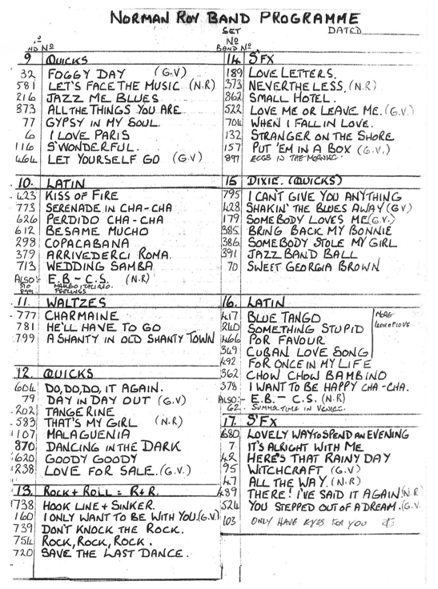
Agenda
Introduction
The Hidden Dance Bands
The Local Dance Band Environment
  Social & Political Aspects
  Infrastructure
Conclusions, & Next Steps

Slide 3
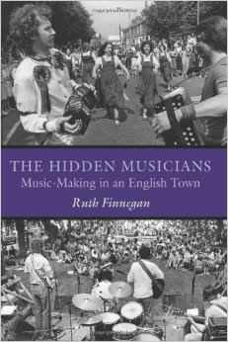
Introduction
Background:
The Hidden Musicians (Finnegan, 2007)
Jazz Places (Becker, 2004)
Rock Culture in Liverpool (Cohen, 1991)
Other Voices (Brocken, 2010)
Victory Through Harmony (Baade, 2013)
Notes:
Inspirations for this oral history project include The Hidden Musicians (Finnegan, 2007), Jazz Places (Becker, 2004), Rock Culture in Liverpool (Cohen, 1991), Other Voices (Brocken, 2010) and Victory Through Harmony (Baade, 2013). It is hoped that combining ideas from these and other sources with a detailed investigation of this specific local scene, as this work has done, will contribute further to a better understanding of amateur and semi-professional music-making in an urban landscape.
PhD project
Building on this, a specific example: not Milton Keynes in the 80s, but Chester in the 30s - 70s
“… the work of local amateur musicians is not just haphazard or formless, the result of individual whim or circumstance. On the contrary, a consistent - if sometimes changing - structure lies behind these surface activities. The public events … are part of an invisible but organised system through which individuals make their contribution to both the changes and the continuities of English music today.”
(Finnegan, 2007)

Slide 4
Research Questions
Finnegan (2007) refers to the ‘invisible but organised’ underlying structure of local music-making
My study was based on a detailed investigation of a specific local scene, in this case, dance bands in Chester & North Wales
Goal: to contribute to a better understanding of amateur and semi-professional music-making in a regional landscape
Questions:
  How did this local dance band scene operate?
  Why there? Why then?
Notes:
'invisible but organised' underlying structure
Research Questions
How did the scene operate?
Why Chester? Why then?

Slide 5
The Local Dance Band Scene
Oral history project
  Based on Chester
    Also taking in Cheshire, North Wales, Wirral, Liverpool, plus other places in UK & overseas
  30 interviews
  200+ photographs and images
  Most of this information was not available in public archives
3 minute video
  A flavour of what my interviewees were talking about..
Notes:
Oral history; data not available elsewhere
30 interviews, 200 photos
The infrastructure which had supported the dance bands is an essential, if under-recorded, part of the history of rock 'n' roll and beat bands in the area (including the Beatles)
but didn’t disappear completely in the 60s
Thriving scene, especially during 1940s & 50s
The Chester Dance Band scene

Slide 6
The Hidden Dance Bands
Why a hidden history?
Hit parades & histories of popularity
  ‘moment of exchange … not use’ (Nott, 2002)
    e.g., an arrangement might be bought once, but played 100s of times
A regional scene
  Most musicians not full-time professionals
  Derivative & imitative rather than innovative
So why worry?
  Infrastructure
    Physical, organisational, human
There’s another Ph.D in who Jimmy Lally really was….
Notes:
Negatives: not ‘original’, not full time
A Hidden History - but why?
But even so, they were there…
& the infrastructure - here, and probably elsewhere too - was important to what came next, which has been extensively, but partially, documented
Provincial (but so was Liverpool…)
The Hidden Dance Bands
Hit Parades as a way of measuring popularity
Moment of exchange vs moment of use
Image of Jimmy Lally arrangement
There’s another Ph.D in who Jimmy Lally really was….

Slide 7
Social & Political Environment
  1920s: The Jazz Age (in the US); UK dance bands
  1930s: BBC suspicion of jazz; MU ban on US visitors
  World War II
    AFN (locally, late in the war)
    Some loosening of restrictions regarding US jazz, ‘sentimental’ songs & crooning on the BBC
    Fuel rationing, call-up of musicians, directed employment
    Large local market (e.g. war factories) which had to be catered for by local, part-time musicians
  50s Austerity; 60s Prosperity
    Despite changes in society, 60s and 70s music scenes were rooted in 50s (& pre-50s) infrastructure
Notes:
+ MU ban on US musicians
Roaring 20s / British dance bands (NOT much US jazz though - mention Baade)
Social & Political
50s Austerity; 60s Prosperity
World War II
ALSO: fuel rationing, call-up of musicians, directed employment
A large local market (e.g. war factories) which had to be catered for by local, part-time musicians
Broadcasting - AFN (locally), a bit more US jazz, loosening of restrictions re. ‘sentimental’ songs & crooning. (Loosening - not removal!)
***
“My brother Robert Fripp, an internationally-acclaimed guitarist and founding and ongoing member of King Crimson, worked in a hotel dance band while going to college. It may interest you to know that he took the job over from a friend who moved to London. That gentleman was Andy Summers, of the famed rock band, The Police.
In recent years, Robert and I have teamed up to deliver presentations throughout the country. I share this story he likes to tell, on what he learned from a rabbi while working in a hotel band in Bournemouth, England, during the late 1960s…
“When I was 18-21 [c. 1964~67], I paid my way through Bournemouth College — where I was studying economics, economic history and political history with a special paper on social conditions, 1850-1900 — by playing at the Majestic Hotel in Bournemouth. The Majestic was a well-known Jewish hotel, run by Fay Schneider,”explained Robert.
“The Majestic Dance Orchestra, a quintet, played three nights per week during the winter and four nights in the summer and accompanied visiting cabaret acts on Sundays. In addition to foxtrots, quicksteps and tangos, we would also play weddings and bar mitzvahs. At one bar mitzvah, the chief rabbi addressed the congregation. The directness of his advice and delivery has never left my memory. He spoke very little English, making his point quickly: ‘When you go into your shop, say Hello God! And you will have good business.'”
“This chief rabbi might have said, ‘May we open ourselves to the unconditioned world that our wishing for what is real and true and moves from conscience, hope and faith, acceptance and love, moves into and permeates a world governed by fashion, advertising, taste, habit, inventions, prices of near substitutes, expectations of trends and changes in price, changes in the distribution of income and the quantity and quality of the money supply, that our professional lives might be mediated by the imperatives of necessity and sufficiency.'”
“But he didn’t say this. Firstly, because his English wasn’t very good – and, secondly, because he wasn’t taking a course in economics at Bournemouth College. What the chief rabbi did was to convey a complex and difficult notion – the possibility of an endless and benevolent grace entering our ungrateful and uncaring world - in 15 words: 12 words of one syllable, 3 words of 2 syllables. (One word, ‘business,’ has three syllables but is pronounced as if having two). ‘When you go into your shop, say, ‘Hello, God! and you will have good business.'” Now, that’s a pithy speech.”
Fripp, Patricia. (n.d). Robert Fripp on How a Rabbi Concisely Cast Complexity with Fewest Words. Retrieved from http://www.fripp.com/blog/fripp-how-rabbi-concisely-cast-complexity-with-fewest-words/

Slide 8
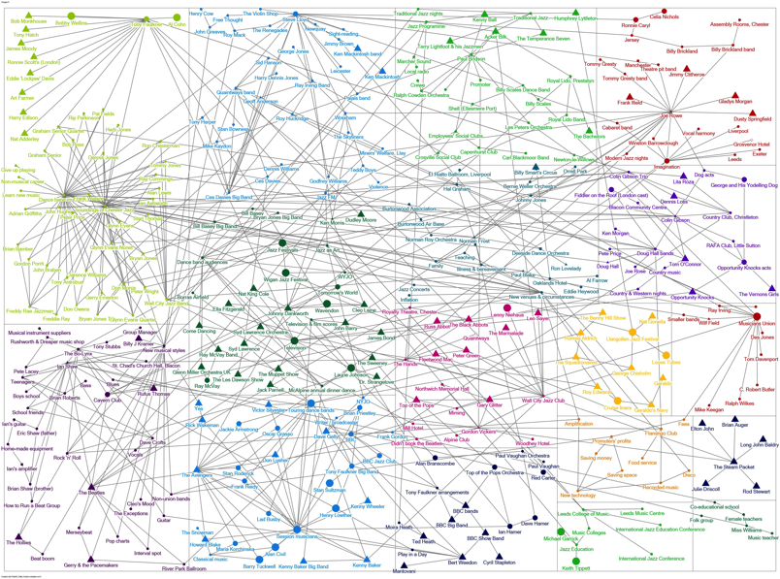
People and Organisations
A complex network
  Strong and weak ties (Granovetter, 1973)
  Visualisation
Bands, musicians, bandleaders & promoters
Teachers & suppliers
  Garrison town: military band instruments (sharp pitch)
  Youth & community organisations
  Employers
  Families
Notes:
SNA, Computer Visualisation
Image of network
Bands, musicians, bandleaders and promoters
Teachers & suppliers
Sharp pitch band instruments
Garrison town; military band cast-offs
The Armed Forces
Local semi-professional musicians
People & organisations
Youth organisations & employers

Slide 9
Location Matters: Dance Bands in a Built Environment
Styles & musical generations overlapped in same venues
  Quaintways (now Rosies)
  Clemences Restaurant
  Chester Jazz Club
  River Park Ballroom, Majestic Ballroom
  Royalty Theatre
  Village halls / employee social clubs
  Military bases
    Delamere Forest camp
    Burtonwood Air Base
    Hawarden aircraft factory (now Airbus)
Notes:
Military bases
e.g Burtonwood
Locations
Chester Jazz Club
Now Rosies
Everything from ballroom to Gary Glitter via Acker Bilk & Peter Green
Despite the changes in society, 60s music scene was still dependent on 50s infrastructure - and to a greater extent than is often appreciated, styles and musical generations overlapped
The pathways didn’t disappear, they evolved
The Beatles played here…
River Park
Royalty Theatre
Hotels & restaurans
Clemences
Village halls & other non-specialist civilian venues
Dance halls
BUILT ENVIRONMENT
Image of map
UK
local
Location really does matter…

Slide 10
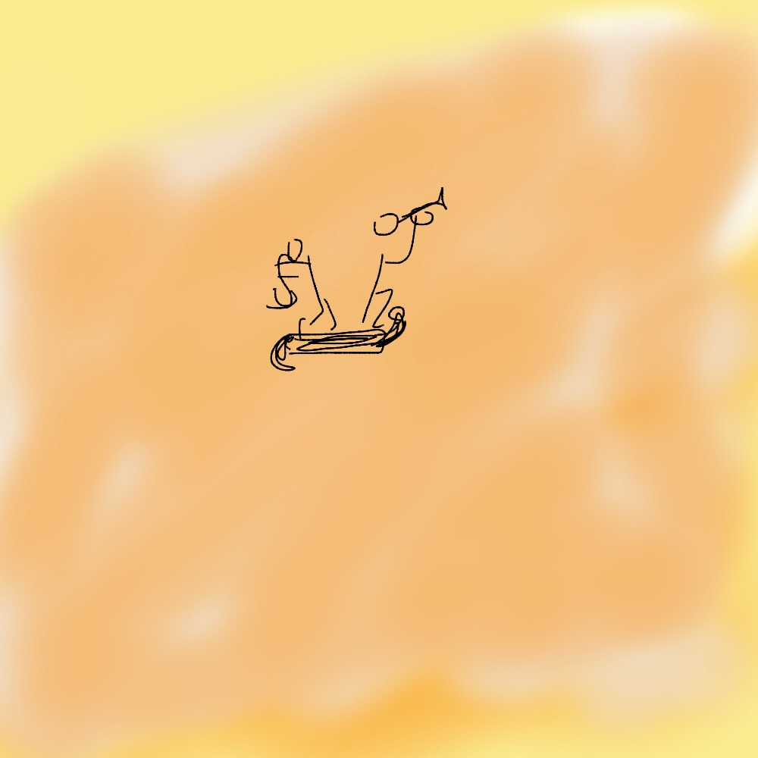
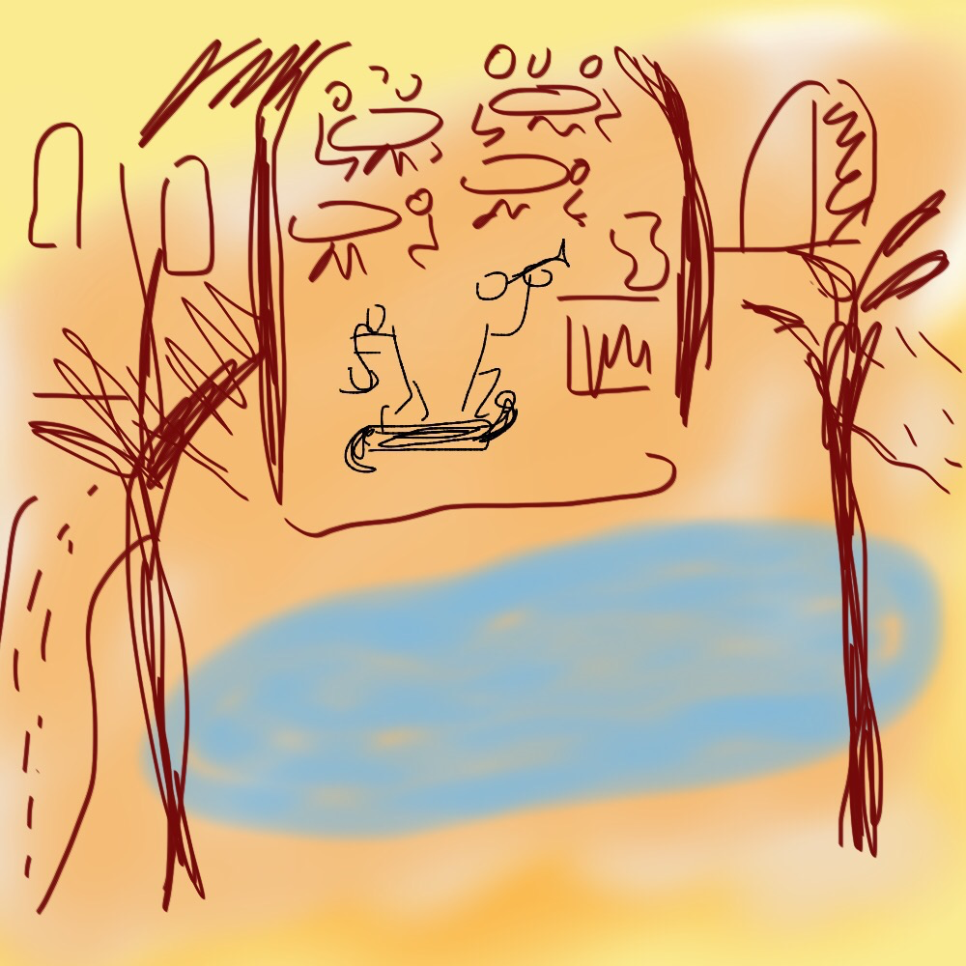
Conclusions
“… the remarkable mixture of music that could be heard live in British towns and cities from the mid-1950s call into question one of the more common record-based assertions, made, for example, in Dave Harker's 'One for the Money':
  'The period 1959-62 was the deadest phase of British and American recorded song since at least 1956 … For adolescents it was a desert. Unless you lived in a major city or coast, or had access to amusement arcade or fairground or made your own music, musically it was a bloody desert. (Harker 1980: 73) (Emphasis in original)
Switch attention from 'recorded song' to live performance and 1959-62 becomes less a desert than a landscape covered with a mass of foliage, from gnarled old trees to newly planted seedlings. Not only were a significant number of adolescents making their own music in this period (including early versions of the Beatles and the Rolling Stones), but they also had a variety of local opportunities to serve musical apprenticeships.”
Frith et al (2013)
Notes:
Not a desert, but a forest…

Slide 11
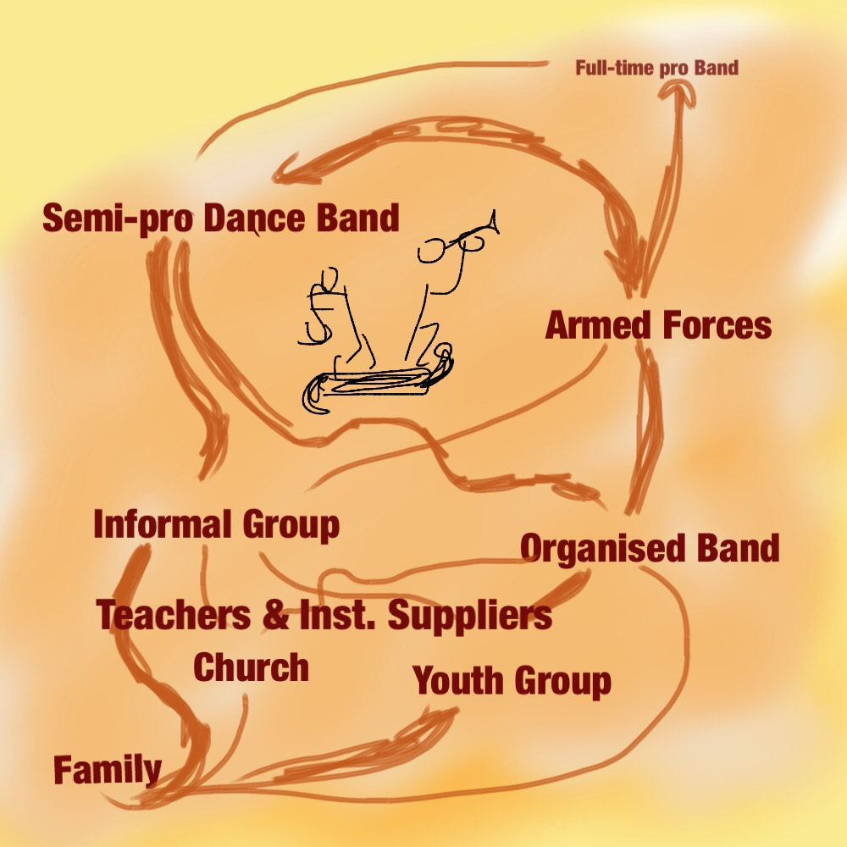
What Next?
Information Visualisation
  Visualising networks and pathways from dance band (and other) data
Digital Humanities Research Centre
  Text and image analysis
  Data-mining of historical source material

Slide 12
References
Baade, Christina L. (2012). Victory through harmony : the BBC and popular music in World War II. Oxford: Oxford University Press.
Becker, Howard S. (2004). Jazz Places. In A. Bennett & R. A. Peterson (Eds.), Music Scenes: Local, Translocal and Virtual (pp. 17 - 27): Vanderbilt University Press.
Brennan, Emily. (2014, November 14). Talking Ships with Sting, New York Times. Retrieved from http://mobile.nytimes.com/2014/11/16/travel/talking-ships-with-sting.html?referrer=&_r=1
Brocken, Michael. (2010). Other voices : hidden histories of Liverpool's popular music scenes, 1930s - 1970s: Ashgate Publishing Ltd.
Cohen, Sara. (1991). Rock Culture in Liverpool : Popular Music in the Making: Oxford University Press.
Finnegan, Ruth H. . (2007). The Hidden Musicians: Music-Making in an English Town: Wesleyan University Press.
Fripp, Patricia. (n.d). Robert Fripp on How a Rabbi Concisely Cast Complexity with Fewest Words. Retrieved from http://www.fripp.com/blog/fripp-how-rabbi-concisely-cast-complexity-with-fewest-words/
Frith, Simon, Brennan, Matt, Cloonan, Martin, & Webster, Emma. (2013). The History of Live Music in Britain, Volume I : 1950 - 1967 - From Dance Hall to the 100 Club: Ashgate.
Granovetter, Mark (1973). The Strength of Weak Ties. The American Journal of Sociology, 78(6), 1360-1380.
Janicke, Stefan, Focht, Josef, & Scheuermann, Gerik. (2015). VIS15 preview: Interactive Visual Profiling of Musicians. VGTCommunity. Retrieved 10th January, 2016
Murrieta-Flores, Patricia, Baron, Alistair, Gregory, Ian, Hardie, Andrew, & Rayson, Paul. (2015). Automatically Analyzing Large Texts in a GIS Environment: The Registrar General's Reports and Cholera in the 19th Century. Transactions in GIS, 19(2), 296-320.
Nott, James J. (2002). Music for the People : Popular Music and Dance in Interwar Britain: Oxford University Press.

